Slide 1
Build, break, secure, and administer a virtual machine
Presented by Abu Sekikongo

Slide 2
Brief project description.
School name : Massbay community college
Mentor : Nicholas Jesi
Category : Cybersecurity
Objective: The major objective of this project is to build, intentionally weaken, secure, and administer a Linux Mint virtual machine in order to demonstrate practical skills in system configuration, vulnerability identification, security hardening, and ongoing system administration

Slide 3
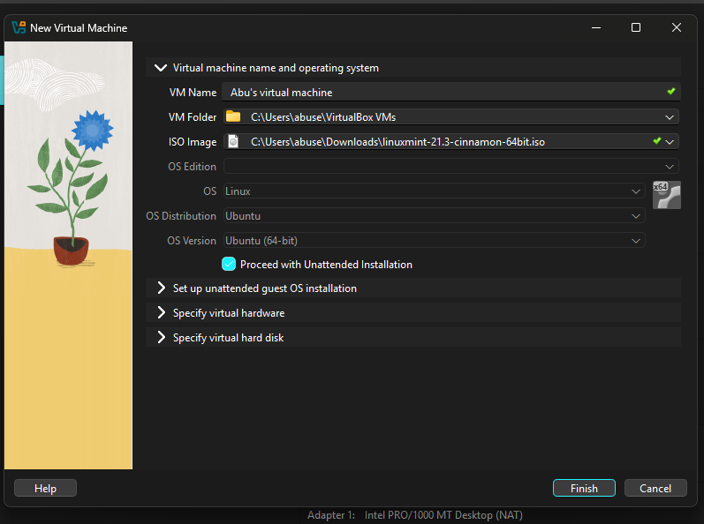
THE BUILDING PHASE
The virtual machine was built using the GUI and below are some specifications;
Operating system: Linux
Os distribution: ubuntu
Os version : ubuntu(64-bit)

Slide 4
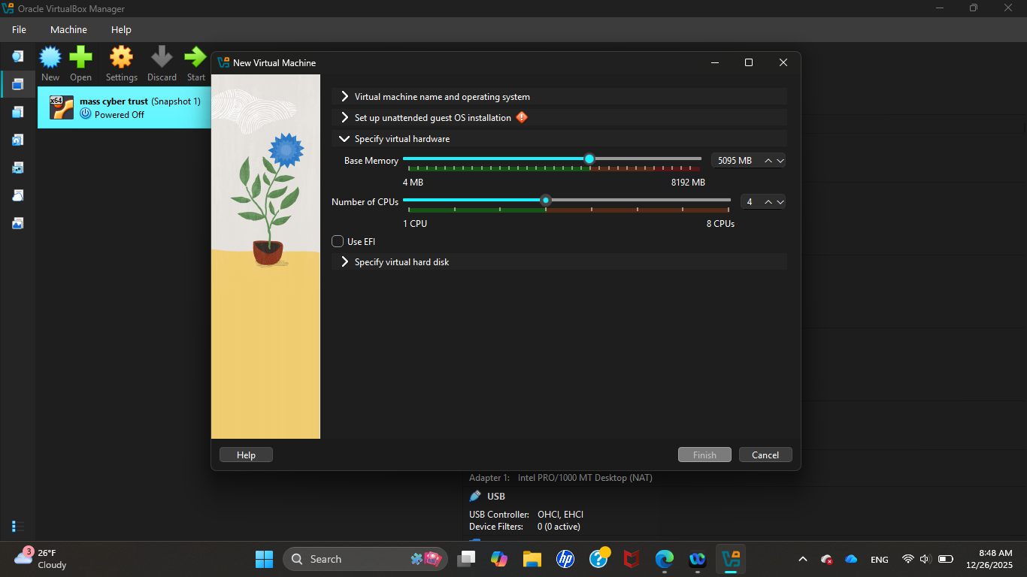
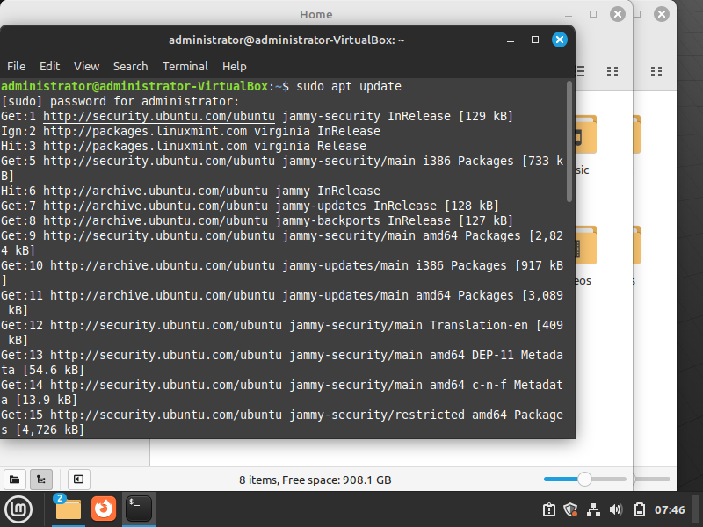
Choosing the base memory and number of CPUs
Installing the necessary applications.​

Slide 5
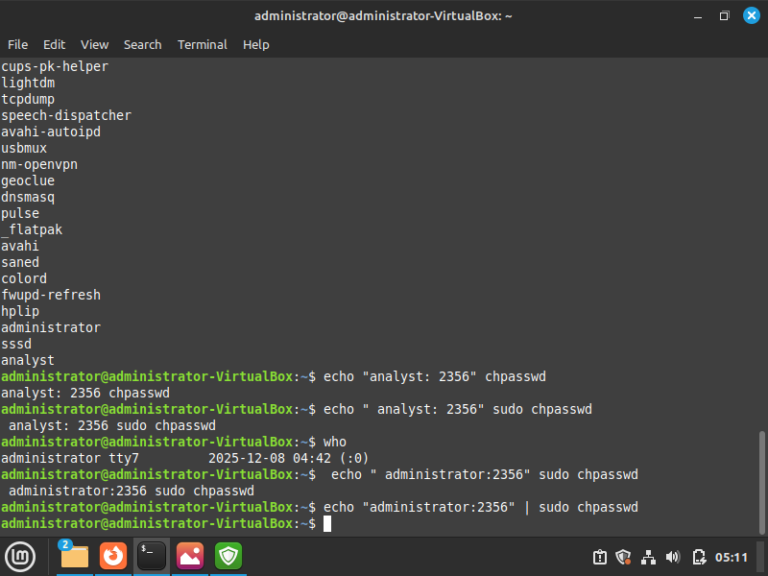
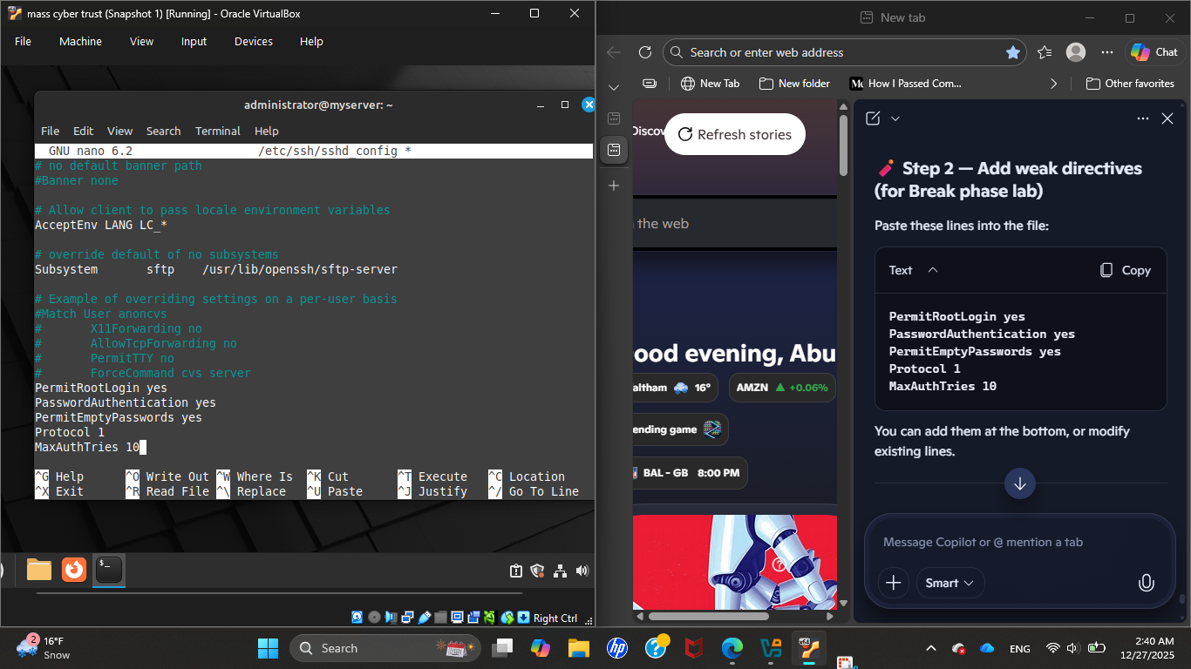
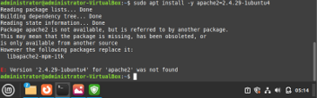
THE BREAK PHASE
Changing the password to a weak password​
Granting easy access
Installing outdated software

Slide 6
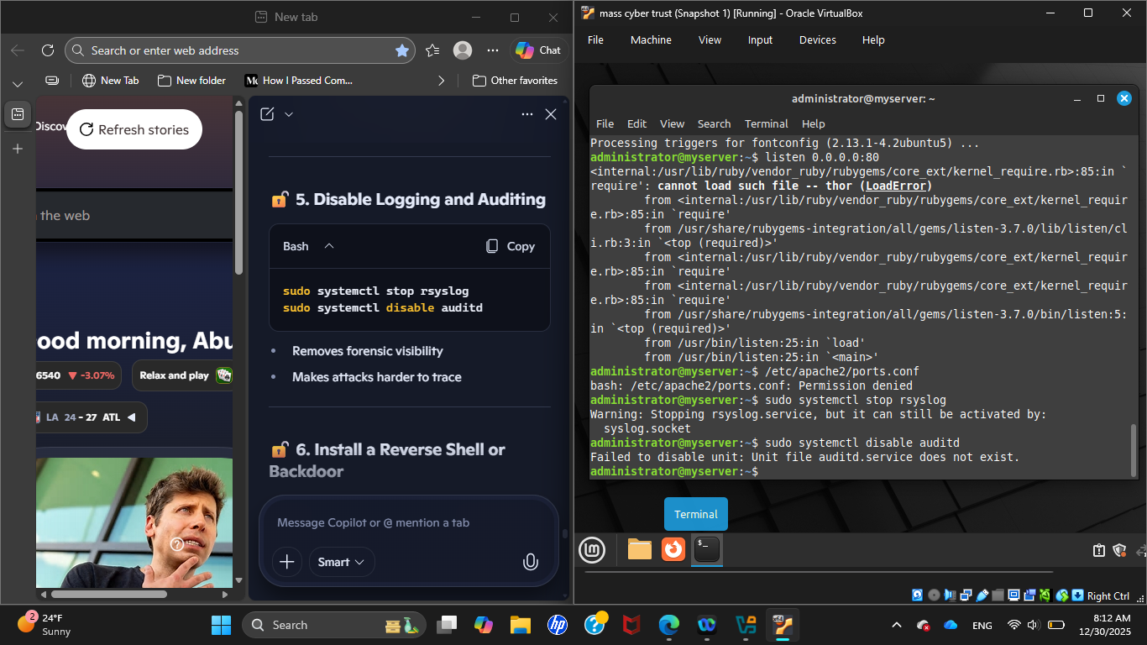
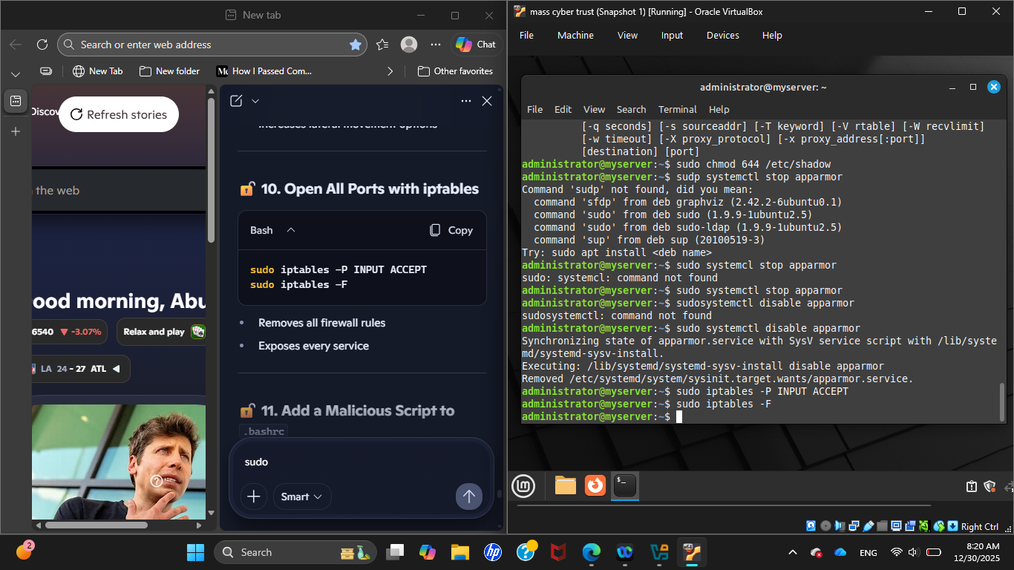
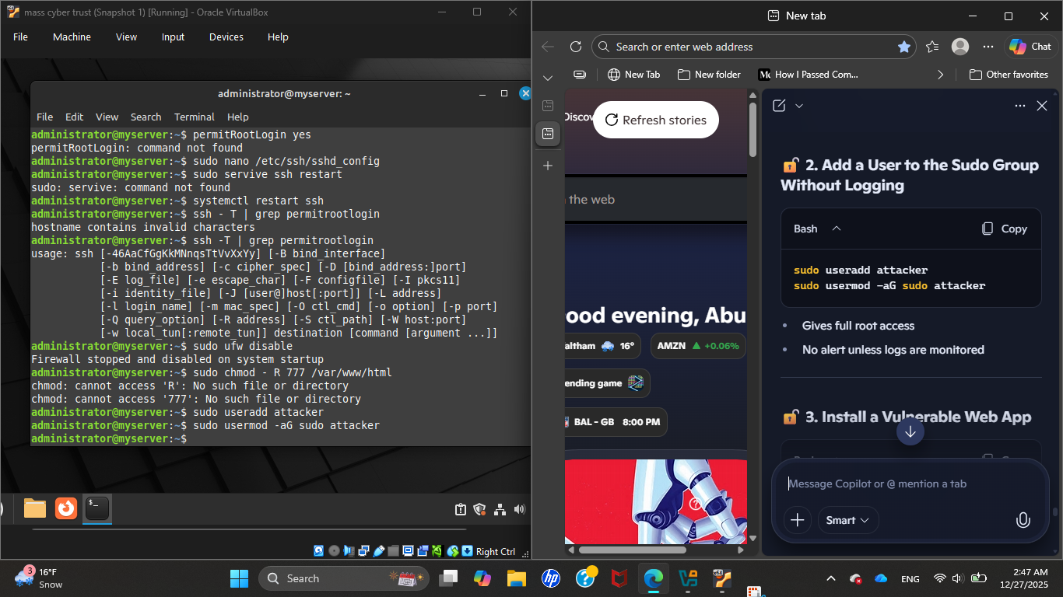
Stopping the syslog to stop writing logs, lose visibility on what's happening, troubleshooting becomes difficult and misconfigurations harder to detect.​
Disabling the firewall.
Removed all firewall rules, set the default policy to allow everything and exposed the system to the entire network and this is very similar to turning off firewall

Slide 7
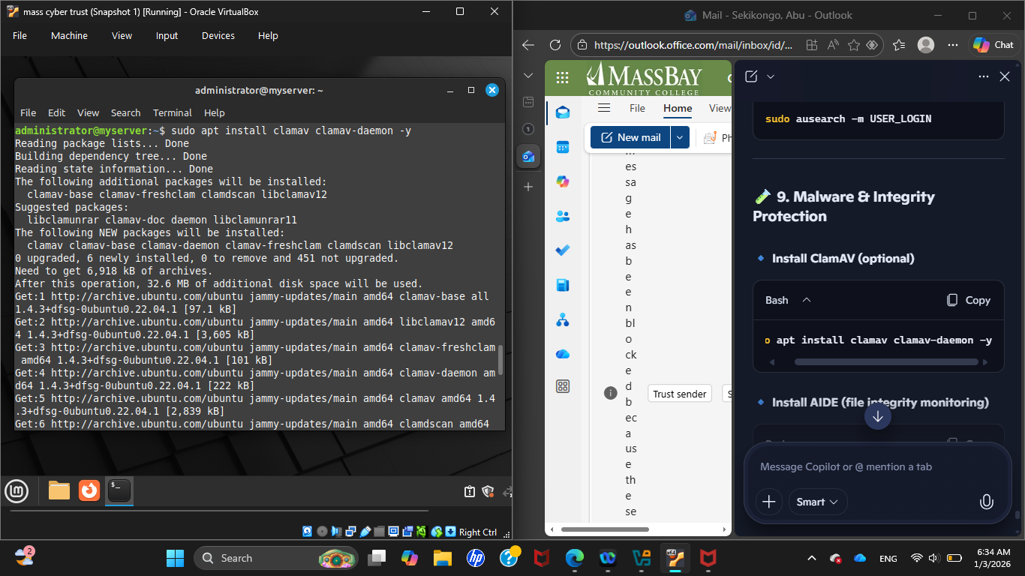
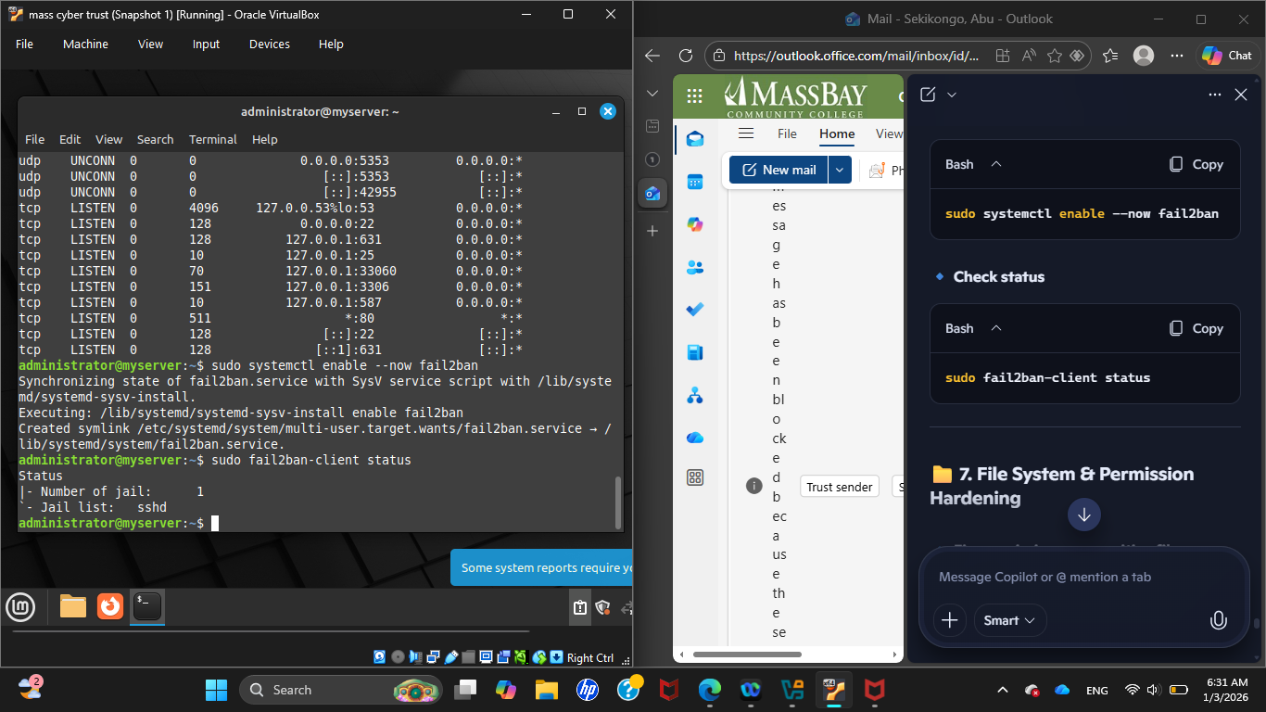
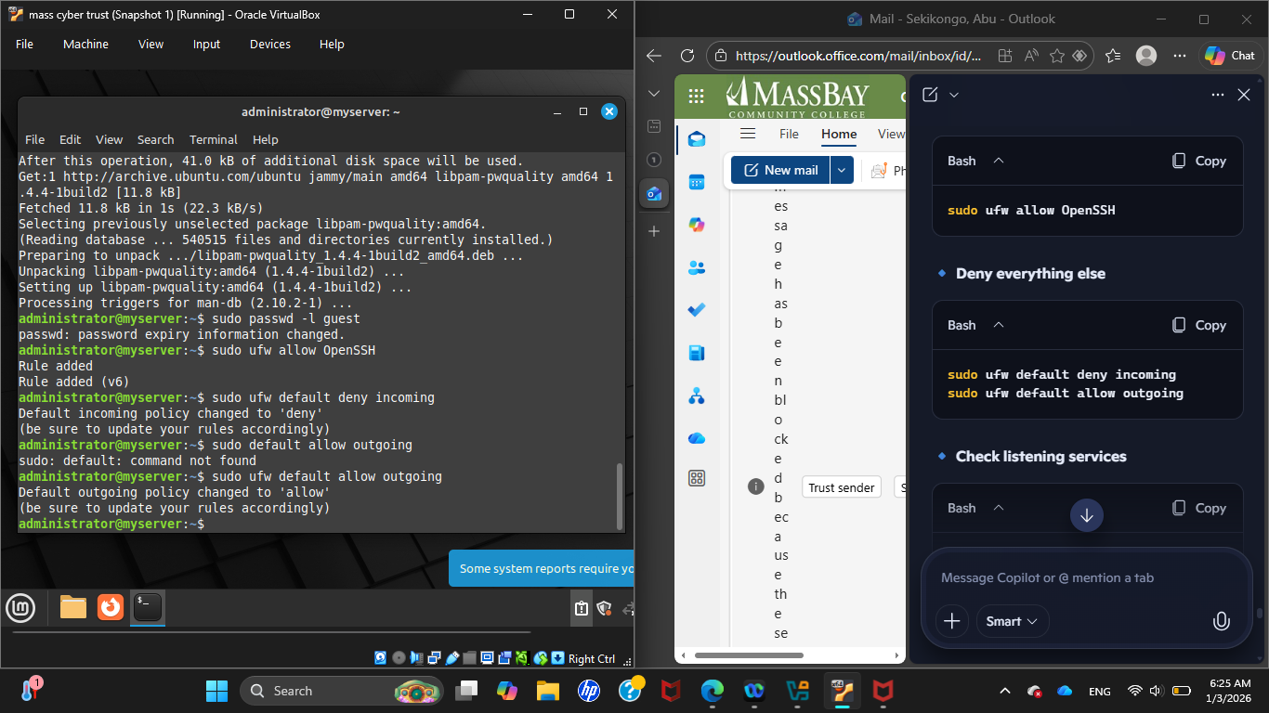
THE SECURING PHASE
Malware integrity and protection.
Installing and enabling fail 2 ban to prevent brute force attacks.
Allow essential ports

Slide 8
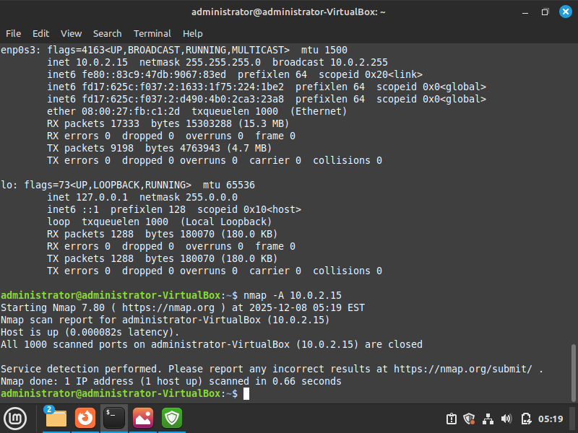
Updating the necessary applications.
Pen testing the system.
Enabling ssh.

Slide 9
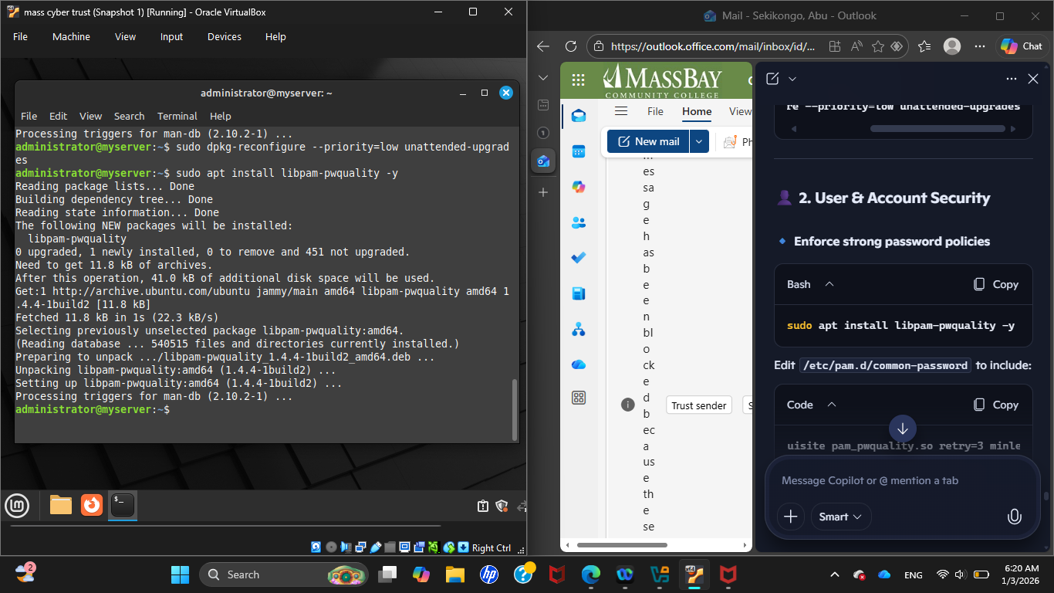
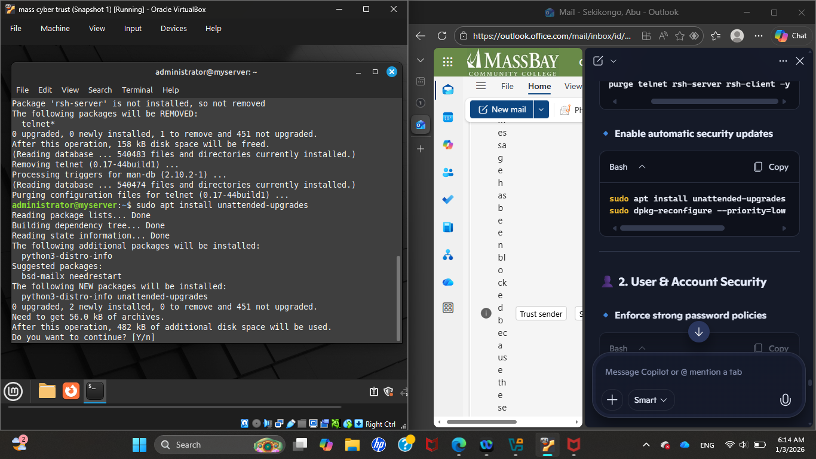
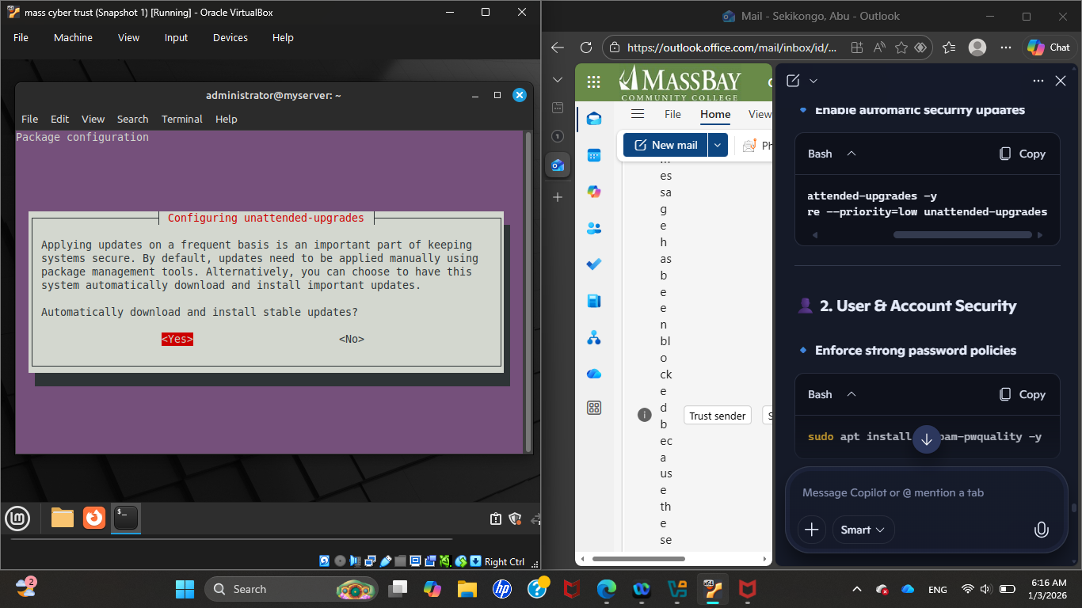
Enforce strong password policies.
Installing unattended upgrades.
Enabling automatic security updates.

Slide 10
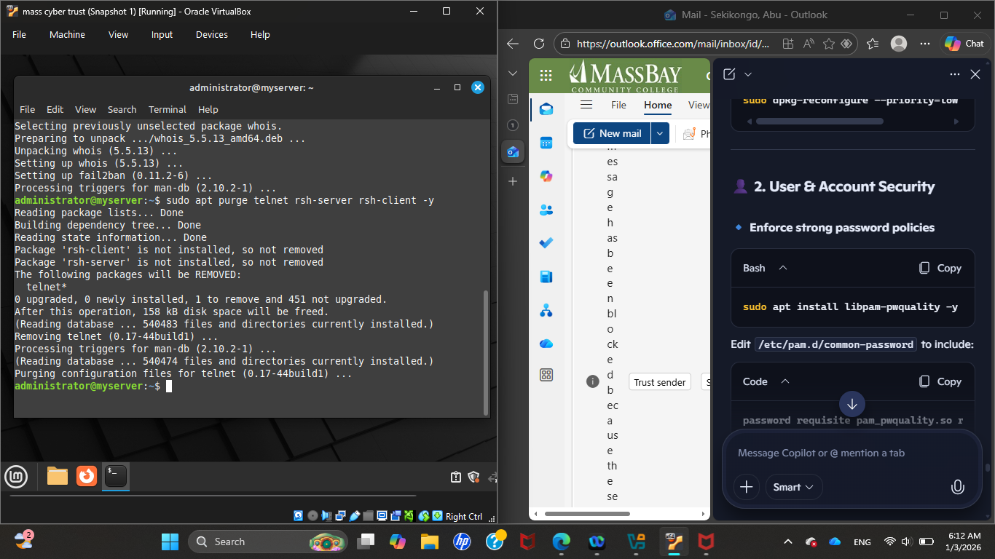
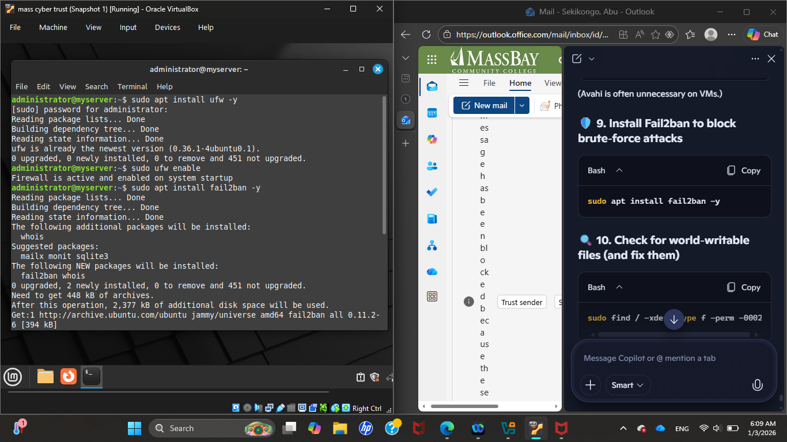
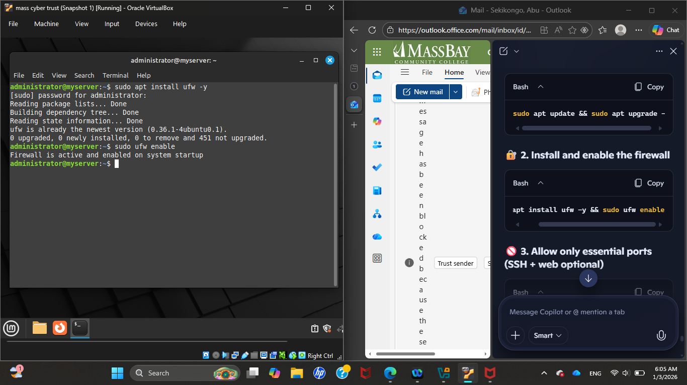
Removing old insecure remote access protocols from the system
Installing the firewall
enabling the firewall

Slide 11
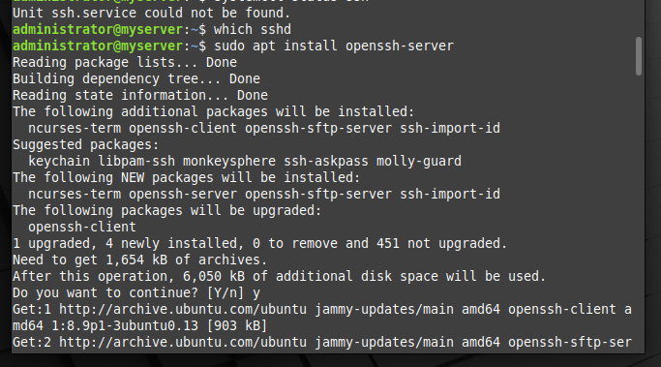
Enabling secure remote login,secure file transfer and a remote administration entry point

Slide 12
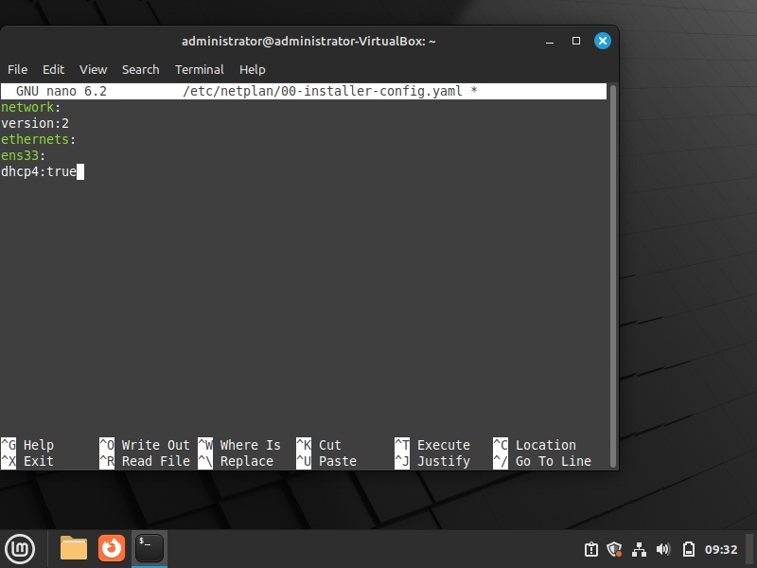
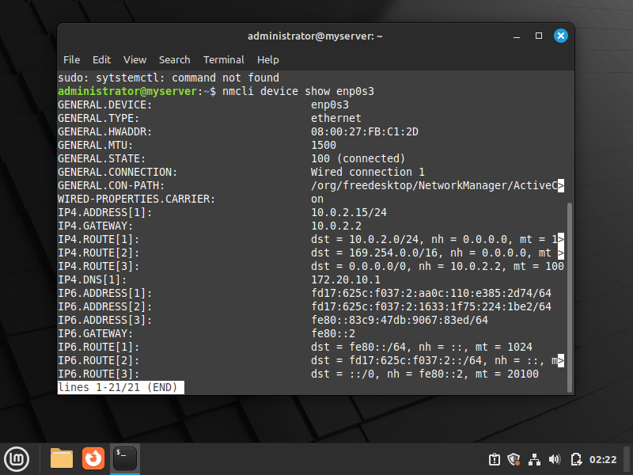
THE ADMINISTERING PHASE
Setting up dhcp
Inspecting interface level configuration by displaying network manager known details.

Slide 13
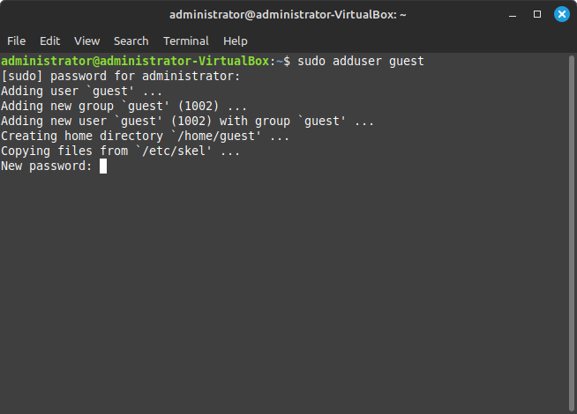
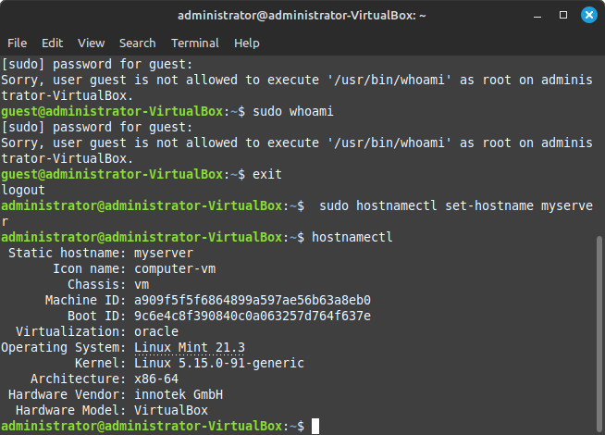
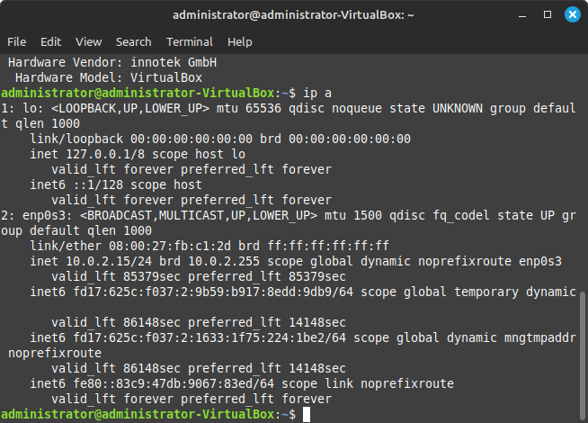
Adding a new user
Setting and confirming host name.
Displaying network interfaces and their assigned Ip addresses.

Slide 14
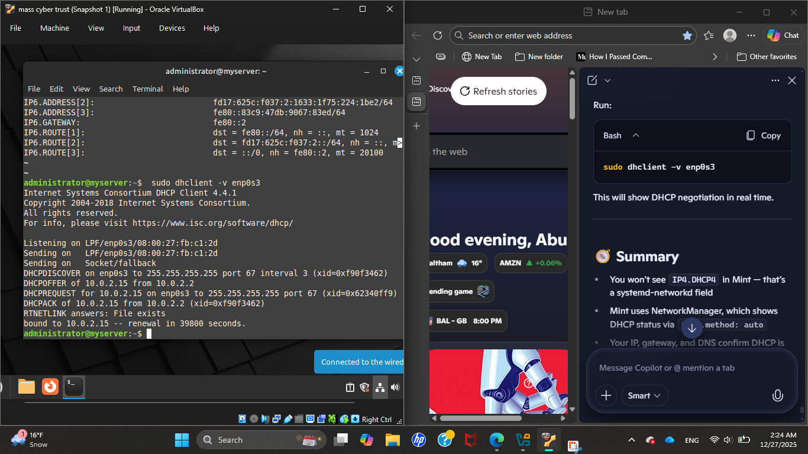
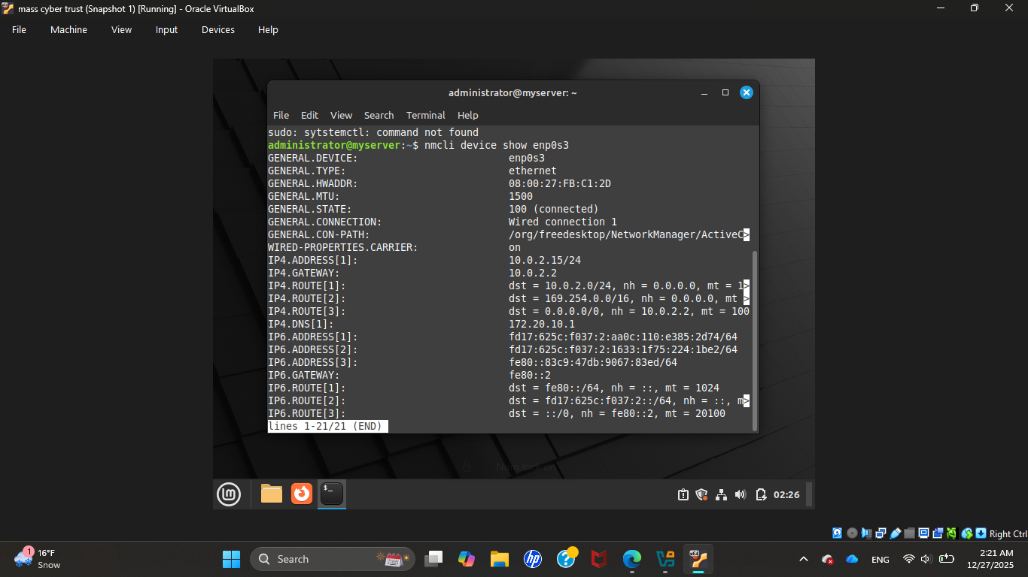
Verifying whether dhcp is working correctly on the virtual machine .
By running the command it forces the machine to actively ask the dhcp server for an ip address
Prints every detail a network manager needs to know about that network interface.

Slide 15
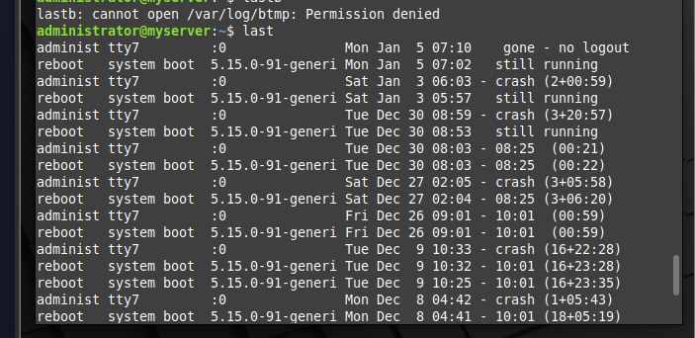
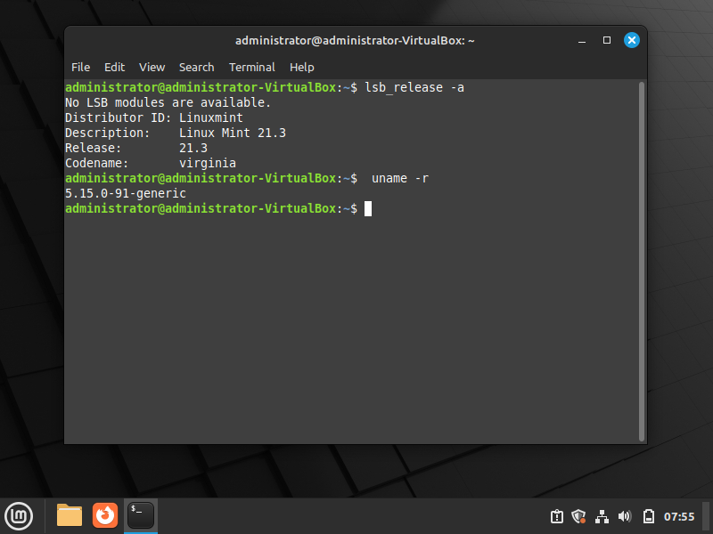
Gives a full audit trail of logins, reboots and session activity.
Information about the Linux version in use ​​​ and the kernel release number ​​​.
Helps confirm if a system is running patched or vulnerable kernel
Helps admin to verify kernel compatability before loading modules or drivers

Slide 16
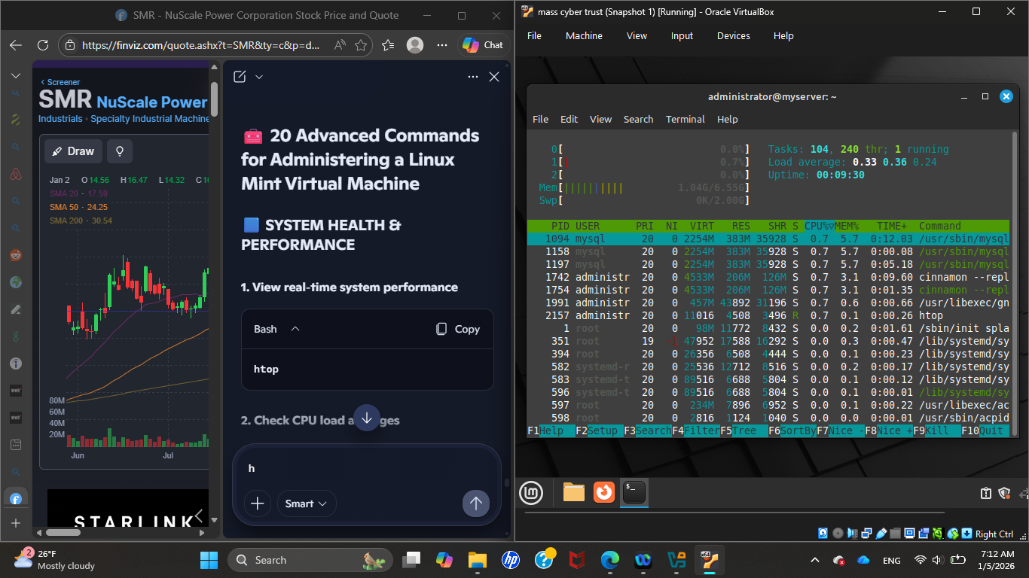
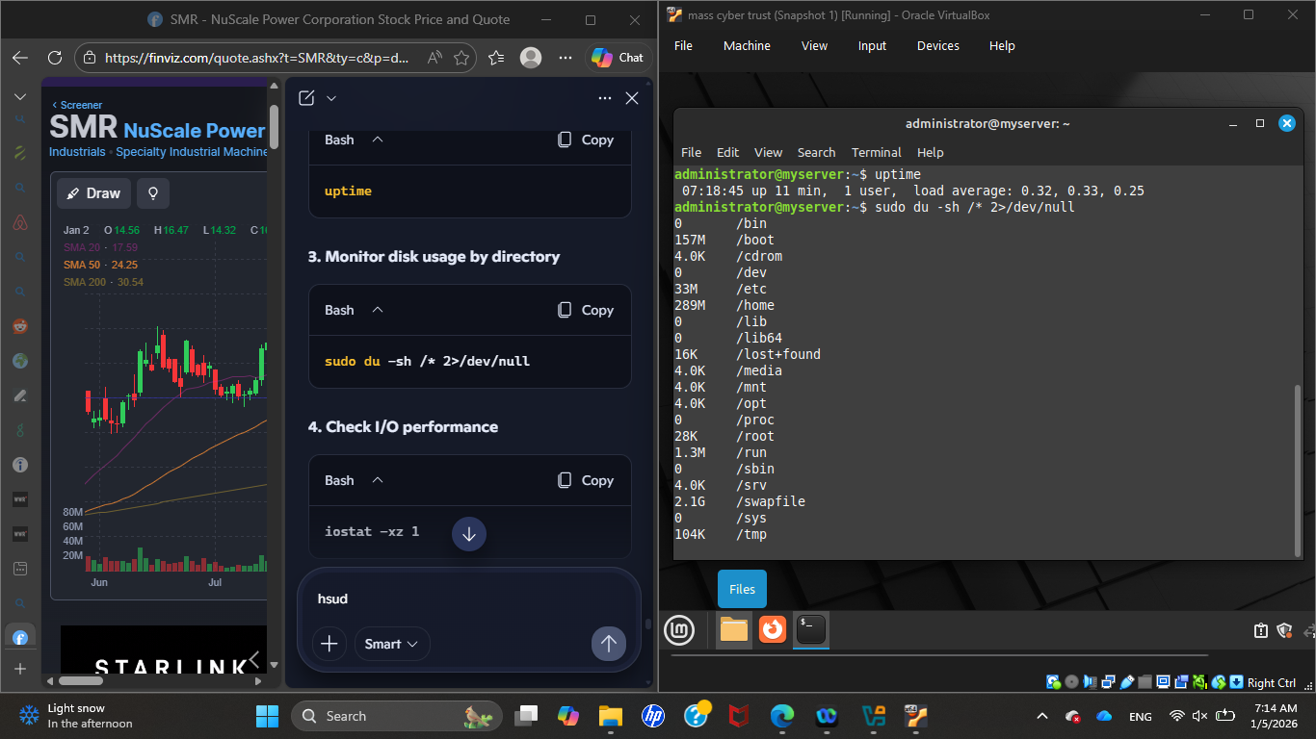
Veiwing real time system performance
Checking CPU load average

Slide 17
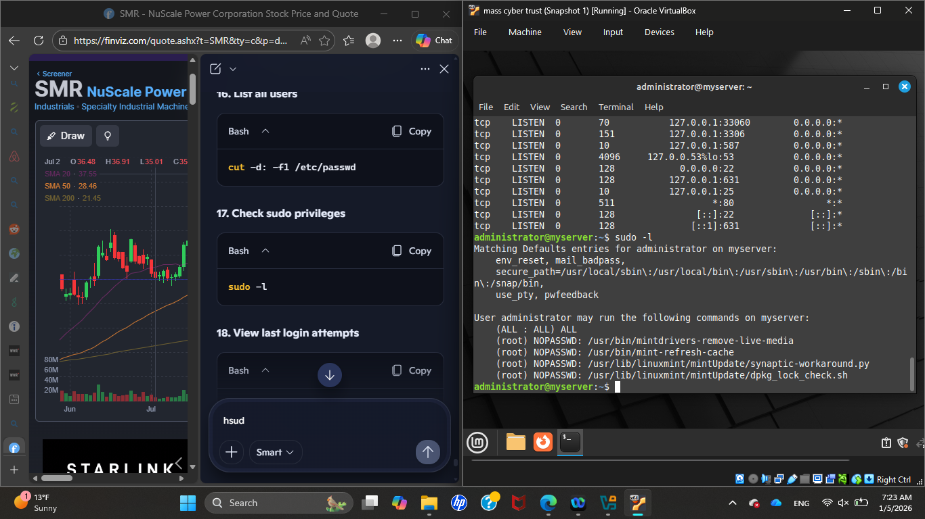
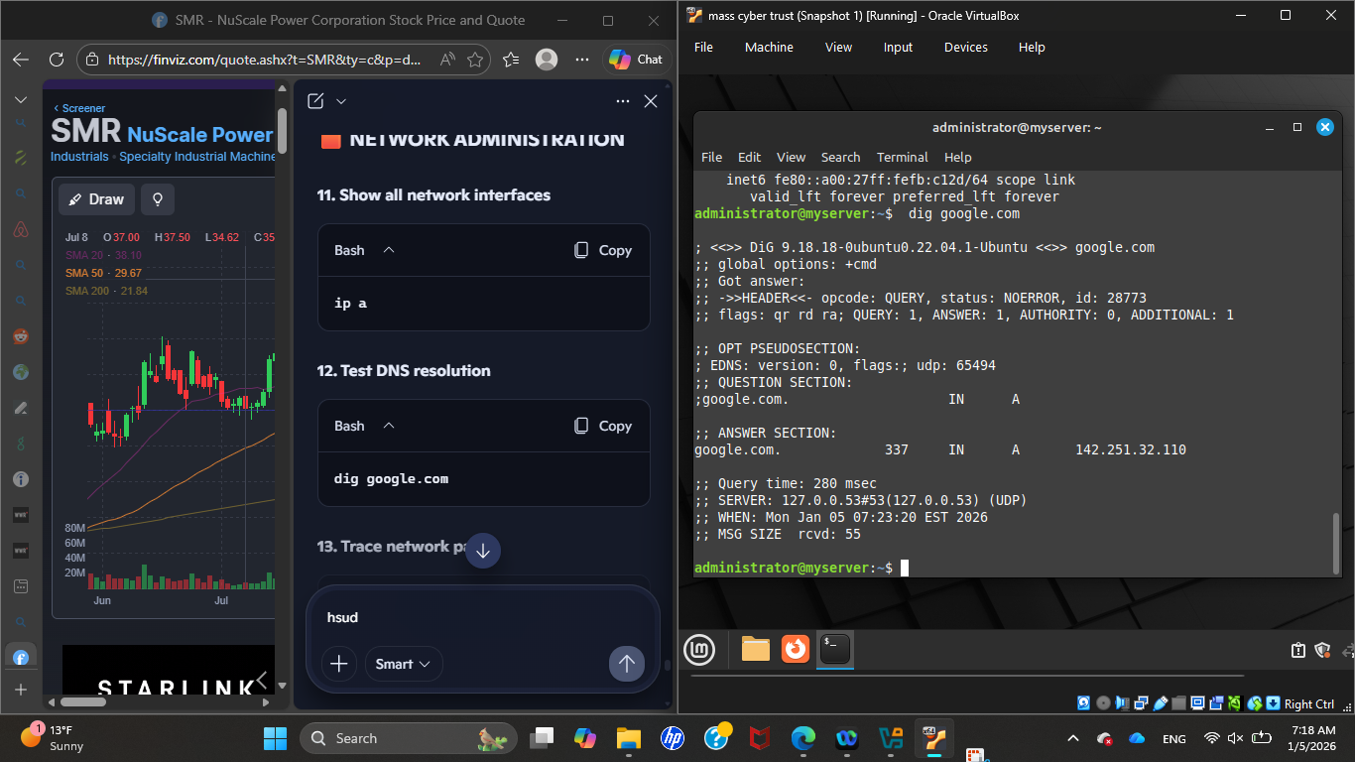
Listing Sudo privileges, which commands a user is allowed to run with Sudo
Testing dns resolution

Slide 18
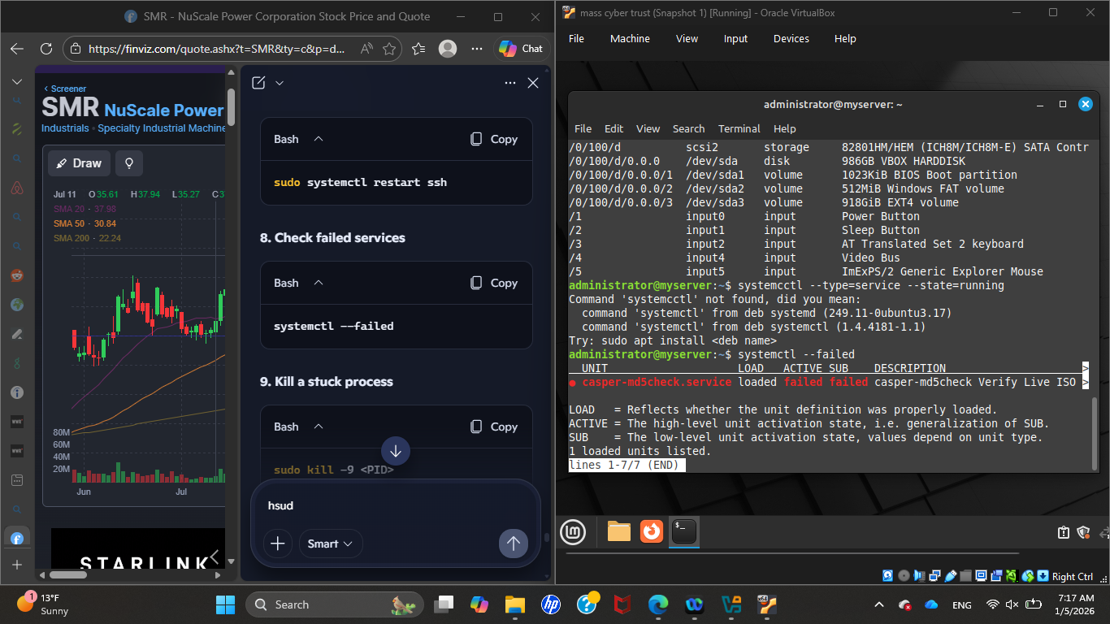
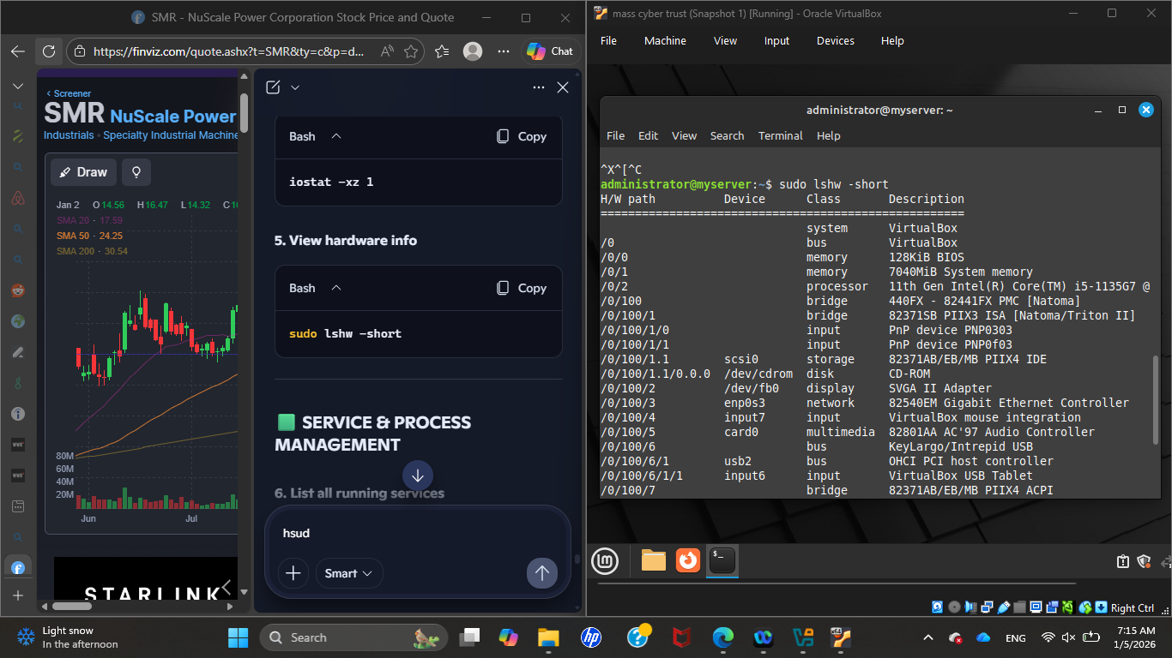
Listing all running services
Viewing hardware info

Slide 19
Challenges
Choosing the right software.
Learning new commands in different fields.
Deciding whether to use a virtual machine or Raspberry Pi.

Slide 20
resources
User Guide for Release 7.2
Chapter 1. Securing RHEL during and right after installation | Security hardening | Red Hat Enterprise Linux | 8 | Red Hat Documentation
cookbook.dvi

